Slide 1
SECRET COMMUNICATION
R. Sai Sathvik [1602-20-737-035]
J. Shyam Prasad Yadav [1602-20-737-042]
M. Sai Laxmi [1602-20-737-034]

Slide 2
ABSTRACT
Our project Secret Communication mainly contains 3 options:
1. Encode
Encode mainly functions on String encryption, Image encryption, Base conversions and ASCII values of string
2. Decode
Decode mainly functions on String decryption, Image decryption, Base conversions and ASCII values to characters
3. Exit

Slide 3
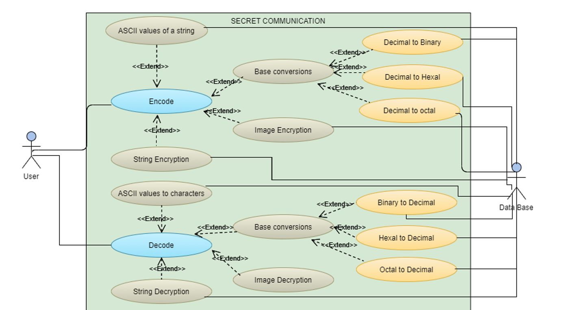
USE CASE DIAGRAM

Slide 4
TECHNOLOGY USED
We used cryptography for encrypting and decrypting data.
From cryptography we imported fernet .
Fernet guarantees that a message encrypted using it cannot be manipulated or read without the key.
Fernet is an implementation of symmetric (also known as “secret key”) authenticated cryptography

Slide 5
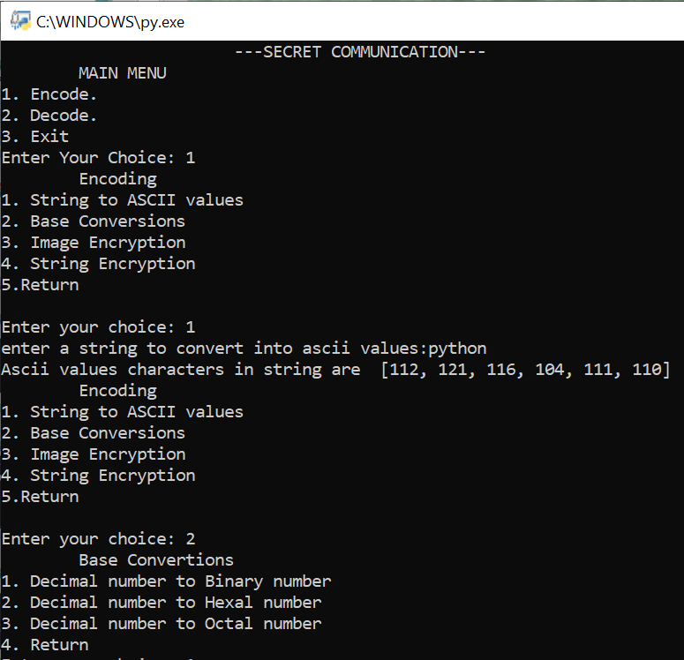
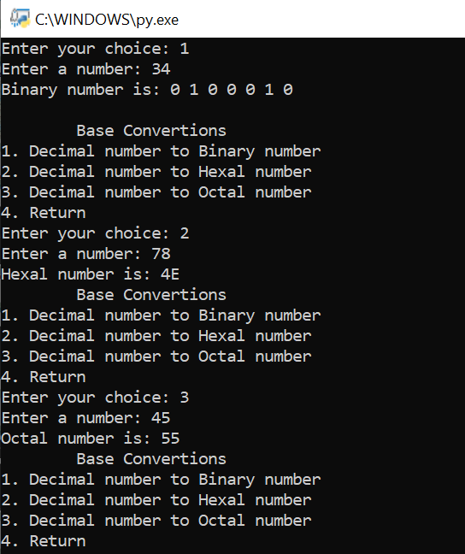
OUTPUTS

Slide 6
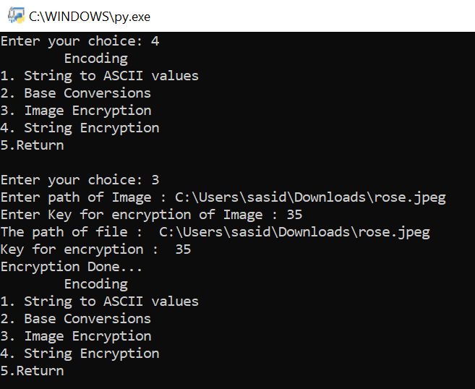
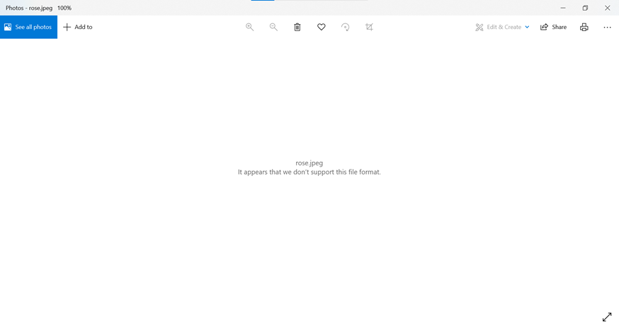
After Encryption

Slide 7
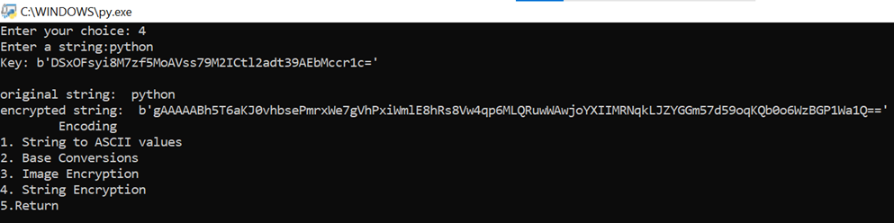
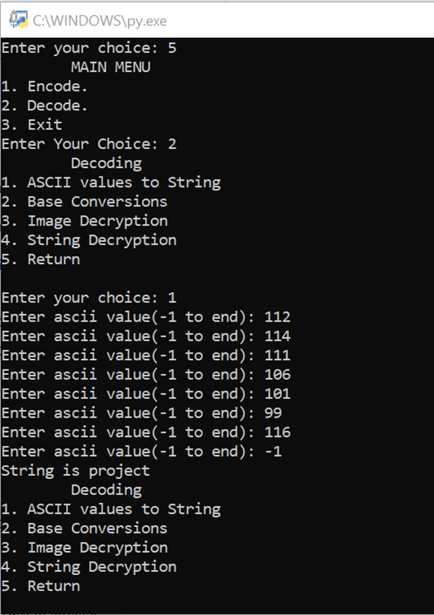
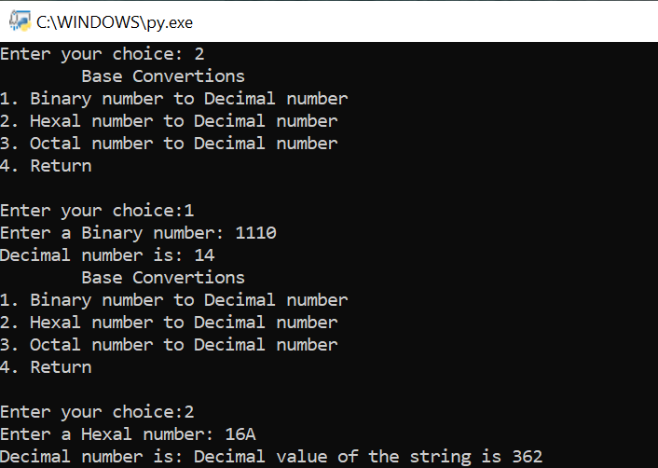

Slide 8
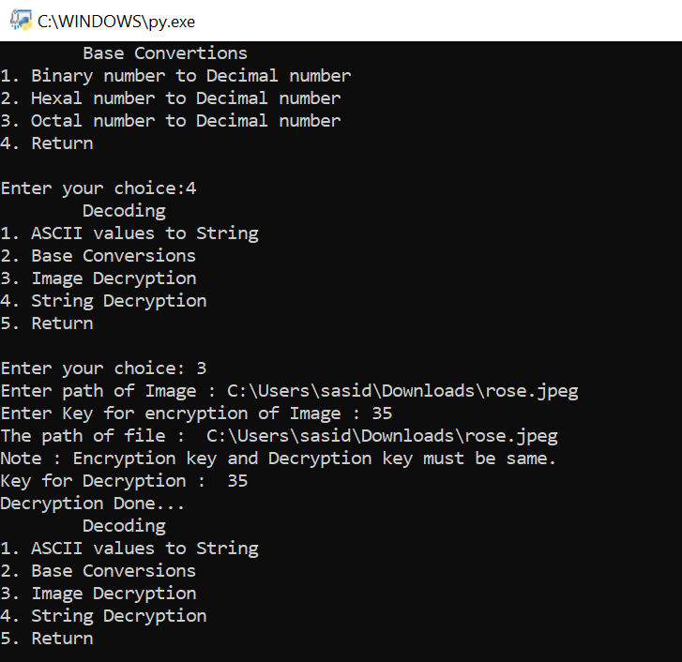
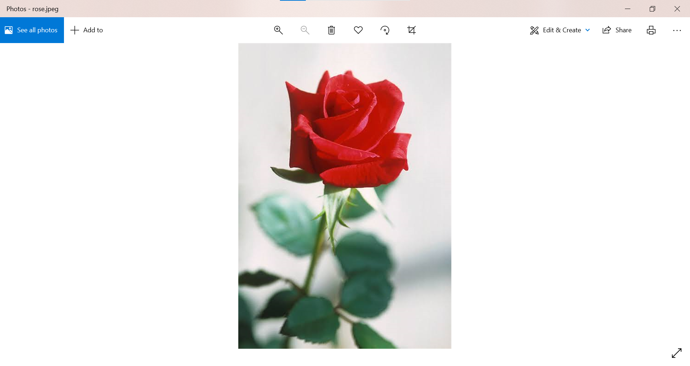
After Decryption

Slide 9
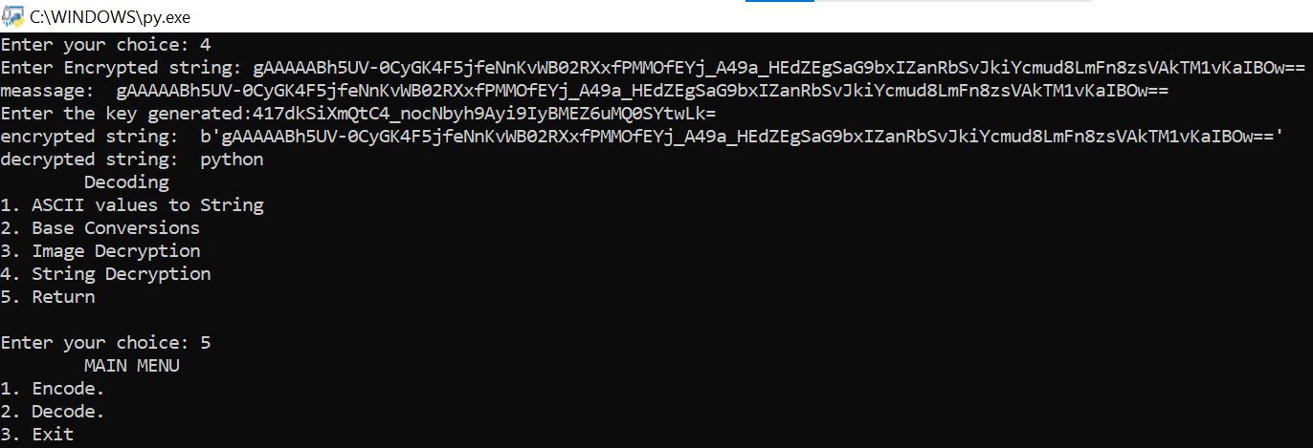

Slide 10
CONCLUSION AND FUTURE SCOPE
Finally our conclusion our project can be widely used in sending secret messages in the field of communication
Even helps students in dealing with digital circuits
In future we want to implement it as a data encryptor and decryptor by storing all the data in files or any Database

Slide 11
THANK YOU!!

